Slide 1
Chapter 3: Logic Gates

Slide 2
Chapter Objectives
After studying this chapter, students should be able to:
Explain the operation of basic logic gates: NOT, AND, OR, NAND, NOR, XOR, and XNOR, using Boolean algebra.
Identify and use both distinctive shape and rectangular outline logic gate symbols according to ANSI/IEEE standards.
Apply logic gates in simple applications and construct timing diagrams to show input-output relationships.
Introduce the concept of programmable logic and compare major IC technologies: CMOS and TTL.
Define and analyze key characteristics: propagation delay, power dissipation, speed-power product, and fan-out.

Slide 3
Chapter Outline
3.1 The Inverter
3.2 The AND Gate
3.3 The OR Gate
3.4 The NAND Gate
3.5 The NOR Gate
3.6 The Exclusive-OR and Exclusive-NOR Gates
3.7 Programmable Logic
3.8 Fixed-Function Logic Gates
3.9 Troubleshooting
Multiple-choice test and Problems

Slide 4
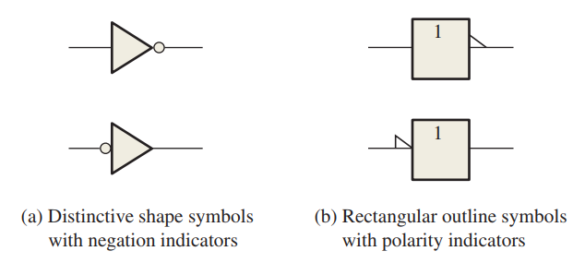
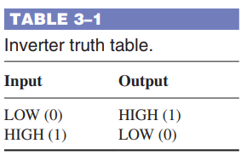
1.1. The Inverter
The inverter (NOT circuit) performs the operation called inversion or complementation. The inverter changes one logic level to the opposite level. In terms of bits, it changes a 1 to a 0 and a 0 to a 1.
Inverter Truth Table
When a HIGH level is applied to an inverter input, a LOW level will appear on its output. When a LOW level is applied to its input, a HIGH will appear on its output.

Slide 5
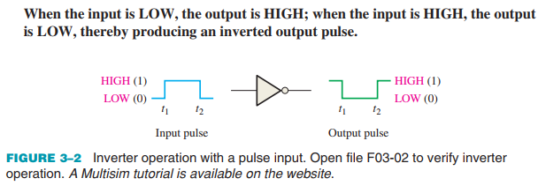
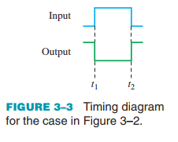
1.1. The Inverter
The Inverter Operation Figure 3–2 shows the output of an inverter for a pulse input, where t1 and t2 indicate the corresponding points on the input and output pulse waveforms. Timing Diagrams: A timing diagram shows how two or more waveforms relate in time.

Slide 6

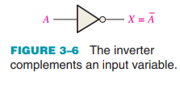
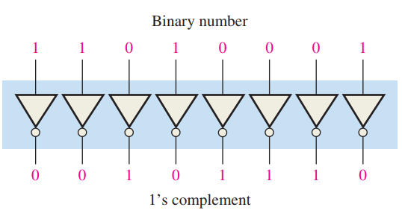
1.1. The Inverter
Logic Expression for an Inverter: Boolean algebra uses variables and operators to describe a logic circuit
An Application
This expression states that the output is the complement of the input, so if A = 0, then X = 1, and if A = 1, then X = 0. Figure 3–6 illustrates this. The complemented variable A can be read as “A bar” or “not A.”

Slide 7
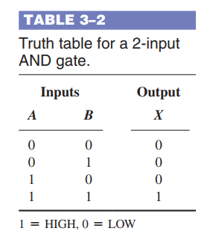
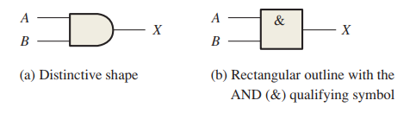
1.2. The AND Gate
The AND gate is one of the basic gates that can be combined to form any logic function. An AND gate can have two or more inputs and performs what is known as logical multiplication.
AND Gate Truth Table: For an AND gate, all HIGH inputs produce
a HIGH output.

Slide 8
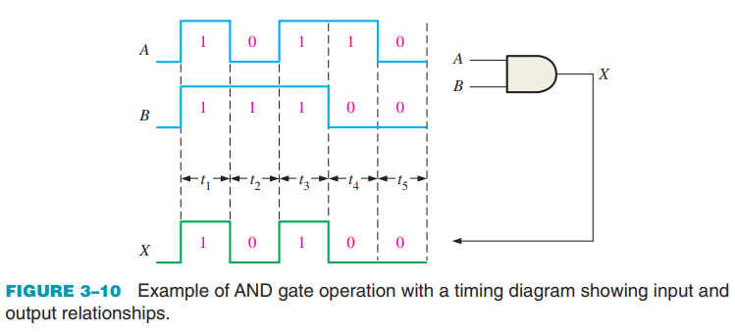
1.2. The AND Gate
AND Gate Operation with Waveform Inputs In most applications, the inputs to a gate are not stationary levels but are voltage waveforms that change frequently between HIGH and LOW logic levels.

Slide 9
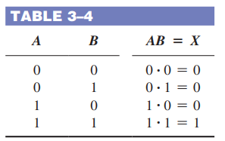

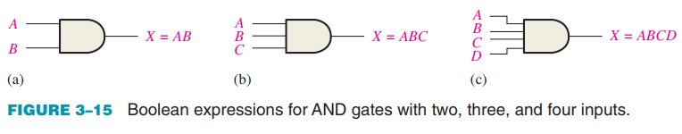
1.2. The AND Gate
Logic Expressions for an AND Gate The logical AND function of two variables is represented mathematically either by placing a dot between the two variables, as A x B, or by simply writing the adjacent letters without the dot, as AB.

Slide 10
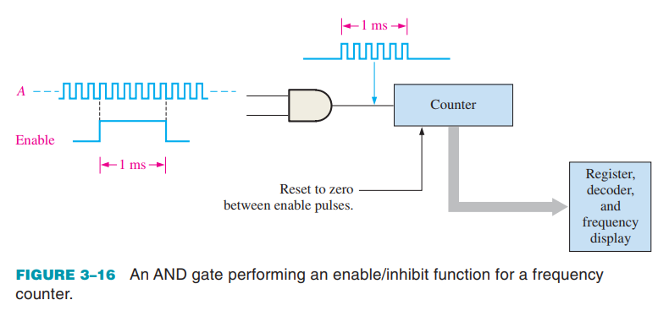
1.2. The AND Gate
The Applications The AND Gate as an Enable/Inhibit Device
A common application of the AND gate is to enable (that is, to allow) the passage of a signal (pulse waveform) from one point to another at certain times and to inhibit (prevent) the passage at other times.

Slide 11
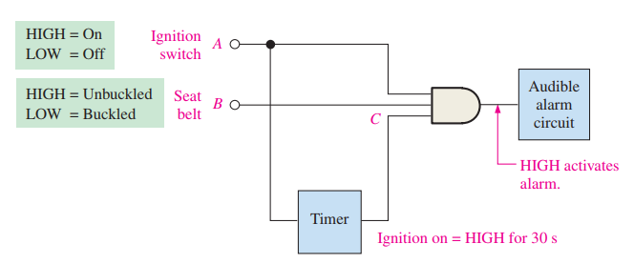
1.2. The AND Gate
The Applications A Seat Belt Alarm System: An AND gate is used in a simple automobile seat belt alarm system to detect when the ignition switch is on and the seat belt is unbuckled.

Slide 12
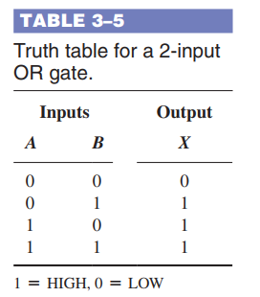
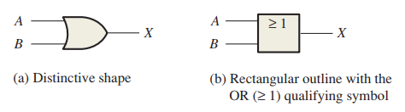
1.3. The OR Gate
The OR gate is another of the basic gates from which all logic functions are constructed. An OR gate can have two or more inputs and performs what is known as logical addition.

Slide 13
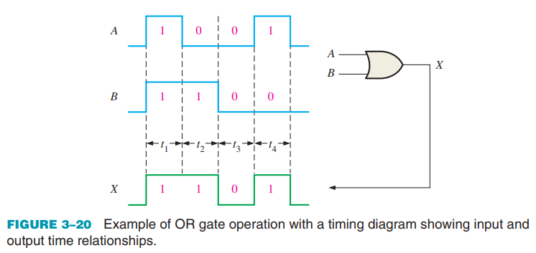
1.3. The OR Gate
OR Gate Operation with Waveform Inputs

Slide 14
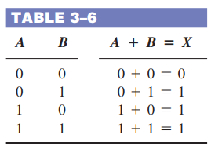

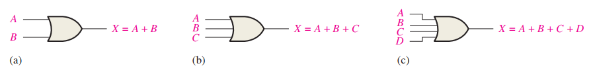
1.3. The OR Gate
Logic Expressions for an OR Gate The logical OR function of two variables is represented mathematically by a + between the two variables, for example, A + B. The plus sign is read as “OR.”

Slide 15
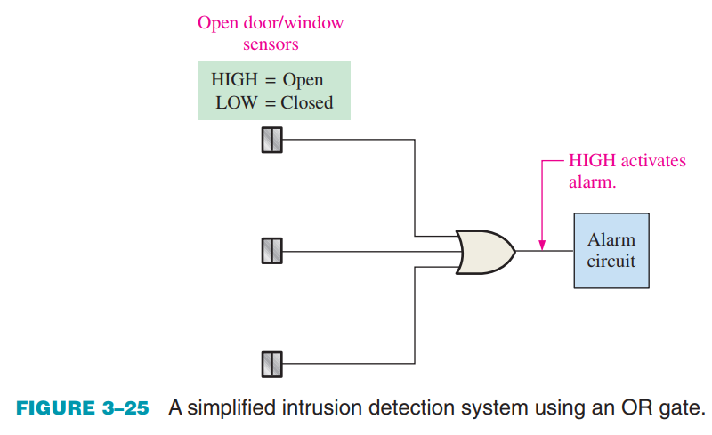
1.3. The OR Gate
An Application A simplified portion of an intrusion detection and alarm system

Slide 16
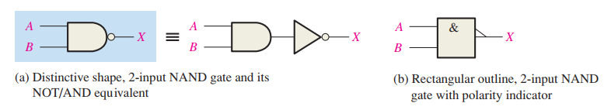
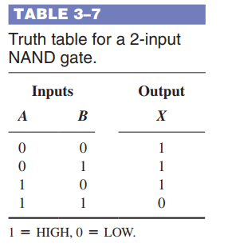

1.4. The NAND Gate
The NAND gate is a popular logic element because it can be used as a universal gate; that is, NAND gates can be used in combination to perform the AND, OR, and inverter operations.

Slide 17
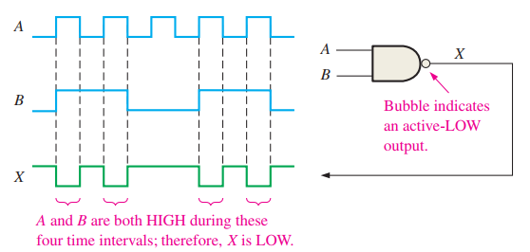
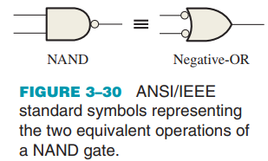
1.4. The NAND Gate
NAND Gate Operation with Waveform Inputs

Slide 18

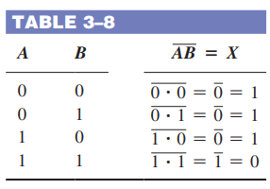
1.4. The NAND Gate
Logic Expressions for a NAND Gate The Boolean expression for the output of a 2-input NAND gate is:

Slide 19
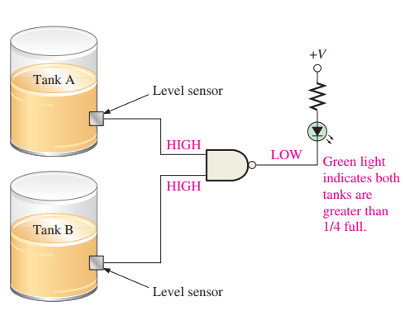
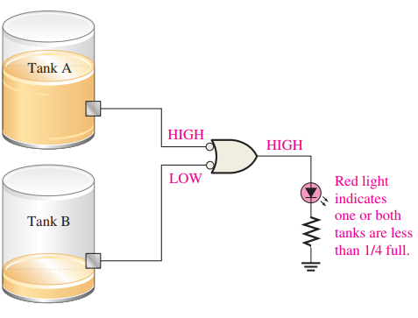
1.4. The NAND Gate
An Application

Slide 20
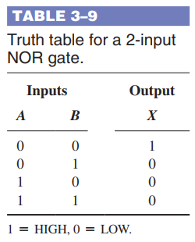
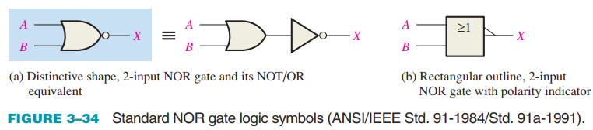
1.5. The NOR Gate
The NOR gate, like the NAND gate, is a useful logic element because it can also be used as a universal gate; that is, NOR gates can be used in combination to perform the AND, OR, and inverter operations.

Slide 21
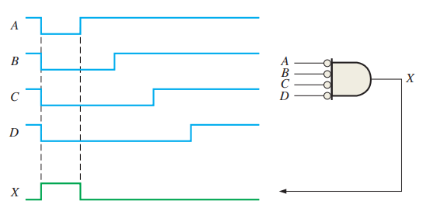
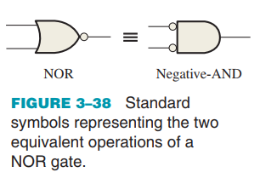
1.5. The NOR Gate
Negative-AND Equivalent Operation of the NOR Gate A NOR gate, like the NAND, has another aspect of its operation that is inherent in the way it logically functions.

Slide 22

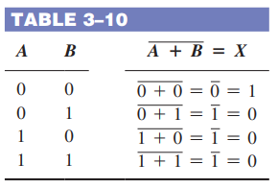
1.5. The NOR Gate
Logic Expressions for a NOR Gate The Boolean expression for the output of a 2-input NOR gate can be written as:

Slide 23
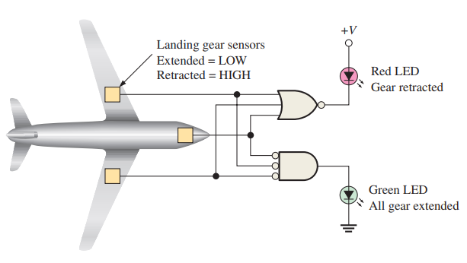
1.5. The NOR Gate
An Application

Slide 24
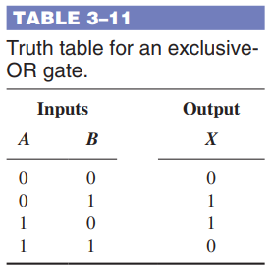
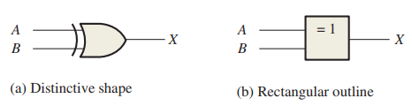
1.6. The Exclusive-OR and Exclusive-NOR Gates
Exclusive-OR and exclusive-NOR gates are formed by a combination of other gates already discussed.
The Exclusive-OR Gate Standard symbols for an exclusive-OR (XOR for short)

Slide 25
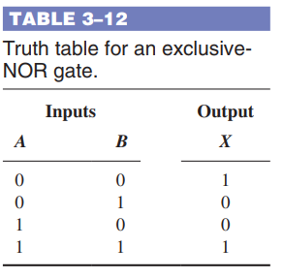
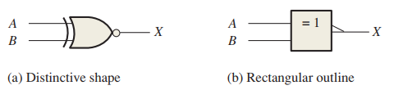
1.6. The Exclusive-OR and Exclusive-NOR Gates
The Exclusive-NOR Gate
For an exclusive-NOR gate, output X is LOW when input A is LOW and input B is HIGH, or when A is HIGH and B is LOW; X is HIGH when A and B are both HIGH or both LOW.

Slide 26
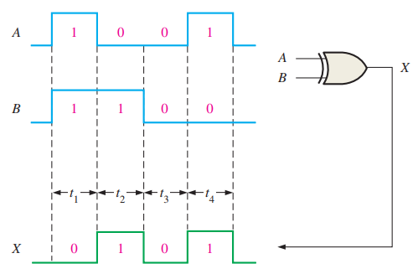
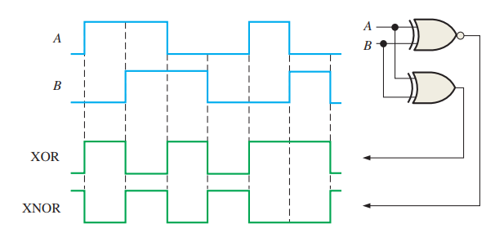
1.6. The Exclusive-OR and Exclusive-NOR Gates
Operation with Waveform Inputs

Slide 27
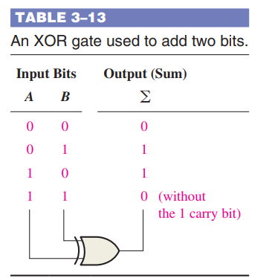
1.6. The Exclusive-OR and Exclusive-NOR Gates
An Application
An exclusive-OR gate can be used as a two-bit modulo-2 adder. Recall from Chapter 2 that the basic rules for binary addition are as follows:
0 + 0 = 0,
0 + 1 = 1,
1 + 0 = 1, and 1 + 1 = 10.
An examination of the truth table for an XOR gate shows that its output is thethe binary sum of the two input bits.

Slide 28
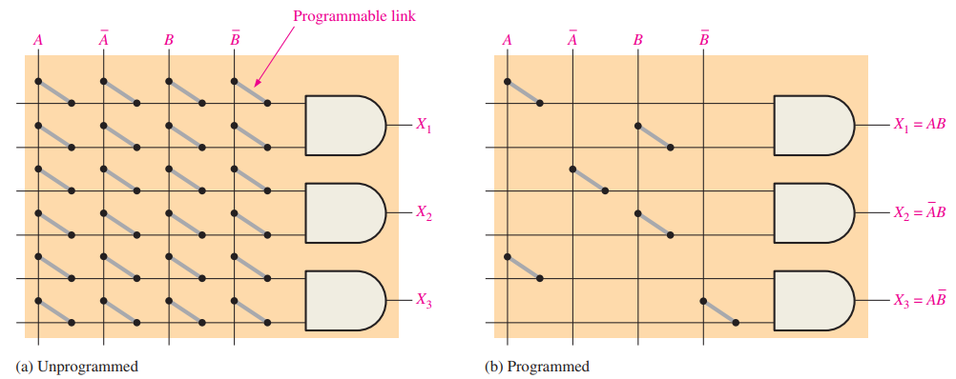

1.7. Programmable Logic
The AND Array Most types of PLDs use some form of AND array. Basically, this array consists of AND gates and a matrix of interconnections with a programmable link at each cross point.

Slide 29
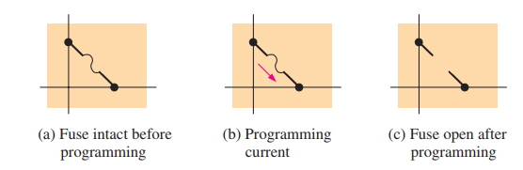

1.7. Programmable Logic
Programmable Link Process Technologies A process technology is the physical method by which a link is made. Several different process technologies are used for programmable links in PLDs. Fuse Technology This was the original programmable link technology. It is still used in some SPLDs. The fuse is a metal link that connects a row and a column in the interconnection matrix.

Slide 30
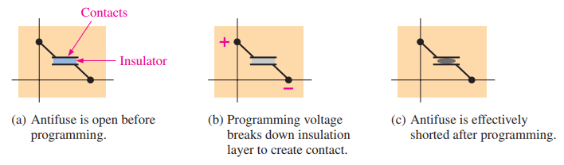

1.7. Programmable Logic
Antifuse Technology An antifuse programmable link is the opposite of a fuse link. Instead of breaking the connection, a connection is made during programming.

Slide 31
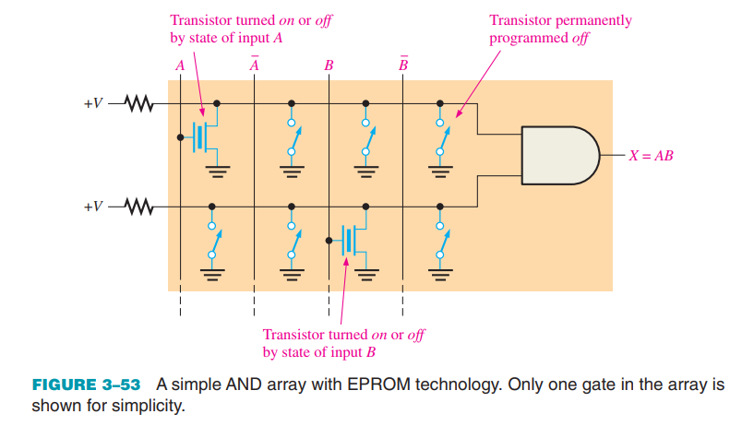
1.7. Programmable Logic
EPROM Technology In certain programmable logic devices, the programmable links are similar to the memory cells in EPROMs (electrically programmable read-only memories). This type of PLD is programmed using a special tool known as a device programmer.

Slide 32
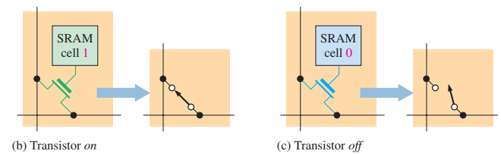
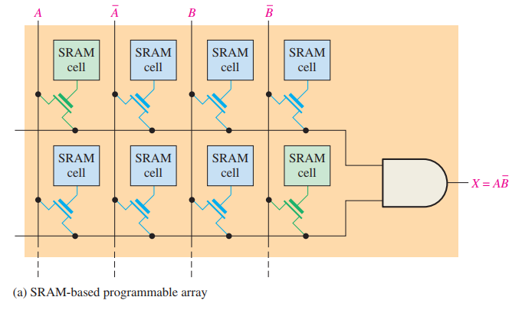
1.7. Programmable Logic
EEPROM Technology Electrically erasable programmable read-only memory technology is similar to EPROM because it also uses a type of floating-gate transistor in cells. Flash Technology Flash technology is based on a single transistor link and is both nonvolatile and reprogrammable. Flash elements are a type of EEPROM but are faster and result in higher density devices than the standard EEPROM link. SRAM Technology Many FPGAs and some CPLDs use a process technology similar to that used in SRAMs (static random-access memories).

Slide 33
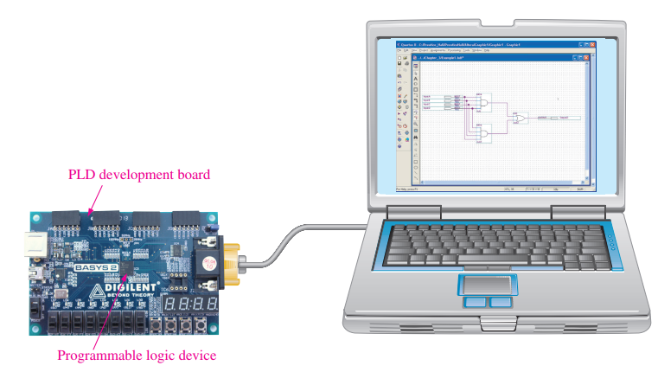
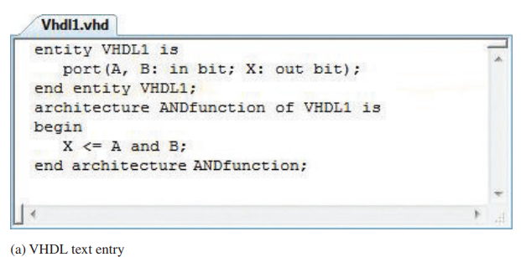
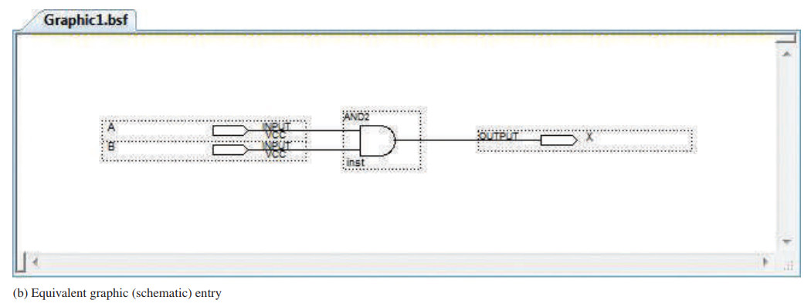
1.7. Programmable Logic
Device Programming
SPLDs, CPLDs, and FPGAs are programmed in essentially the same way
Design Entry is where the logic design is
programmed into the development
software.

Slide 34
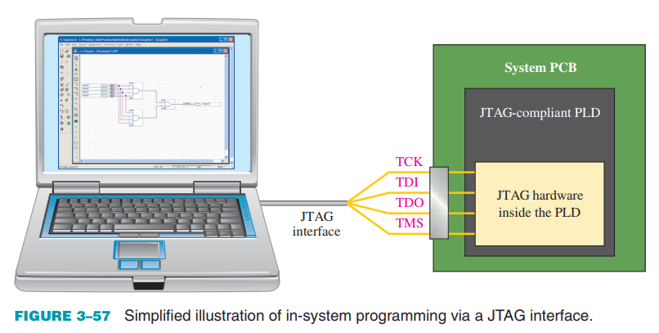
1.7. Programmable Logic
In-System Programming (ISP) Certain CPLDs and FPGAs can be programmed after they have been installed on a system printed circuit board (PCB) JTAG The standard established by the Joint Test Action Group is the commonly used name for IEEE Std. 1149.1.

Slide 35
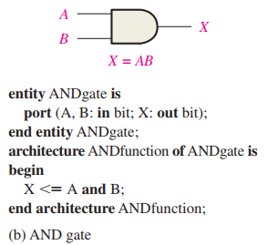


1.7. Programmable Logic
Embedded Processor Another approach to in-system programming is the use of an embedded microprocessor and memory.
VHDL Descriptions of Logic Gates Hardware description languages (HDLs) differ from software programming languages because HDLs include ways of describing logic connections and characteristics.

Slide 36


1.7. Programmable Logic
Embedded Processor Another approach to in-system programming is the use of an embedded microprocessor and memory. VHDL Descriptions of Logic Gates Hardware description languages (HDLs) differ from software programming languages because HDLs include ways of describing logic connections and characteristics.

Slide 37

1.8. Fixed-Function Logic Gates
Fixed-function logic integrated circuits have been around for a long time and are available in a variety of logic functions. 74 Series Logic Gate Functions The 74 series is the standard fixed-function logic devices. The device label format includes one or more letters that indentify the type of logic circuit technology family in the IC package and two or more digits that identify the type of logic function.

Slide 38


1.8. Fixed-Function Logic Gates
AND Gate

Slide 39

1.8. Fixed-Function Logic Gates
NAND Gate

Slide 40



1.8. Fixed-Function Logic Gates
OR Gate NOR Gate

Slide 41



1.8. Fixed-Function Logic Gates
XOR Gate IC Packages

Slide 42

1.8. Fixed-Function Logic Gates
74 Series Logic Circuit Families

Slide 43

1.9. Troubleshooting
Internal Failures of IC Logic Gates Opens and shorts are the most common types of internal gate failures. These can occur on the inputs or on the output of a gate inside the IC package. Before attempting any troubleshooting, check for proper dc supply voltage and ground. Effects of an Internally Open Input An internal open is the result of an open component on the chip or a break in the tiny wire connecting the IC chip to the package pin. An open input prevents a signal on that input from getting to the output of the gate

Slide 44

1.9. Troubleshooting
Troubleshooting an Open Input Troubleshooting this type of failure is easily accomplished with an oscilloscope and function generator.

Slide 45

1.9. Troubleshooting
Shorted Input or Output Although not as common as an open, an internal short to the dc supply voltage, ground, another input, or an output can occur

Slide 46
SUMMARY
Chapter 3: Logic Gates
Logic gates perform operations based on input signals: Inverter (NOT) outputs the complement, AND is HIGH only when all inputs are HIGH, OR is HIGH when any input is HIGH, while NAND and NOR are their respective opposites.
Exclusive-OR (XOR) outputs HIGH when inputs are different; Exclusive-NOR (XNOR) outputs LOW when inputs are different.
Gates can be represented using distinctive shape symbols and truth tables, typically with 2 inputs.
Programmable Logic Devices (PLDs) are usually based on AND arrays and come in forms like fuse, EPROM, EEPROM, flash, SRAM.
PLDs can be programmed using software (HDL or schematic) and reprogrammed in-system (ISP); JTAG is used for programming/testing.
Embedded processors can be used to facilitate in-system programming of PLDs; in contrast, fixed-function logic circuits cannot be changed.
Important parameters include power dissipation, speed-power product, and fan-out. Generally, CMOS consumes less power than TTL.

Slide 47
MULTIPLE-CHOICE TEST AND PROBLEMS
Complete the true/false questions, multiple-choice questions, and end-of-chapter exercises in the primary textbook.

